Slide 1


Chapter 2 Nervous System
Ms. Aisha Bano
aisha.bano@nu.edu.pk

Slide 2
Table of Content
Introduction
Structure of neuron. (Nerve cell, Dendrite, Axon, Myelin Sheath, Synapse), Neurotransmitters (Dopamine, Serotonin, Endorphins, Acetylcholine)
2. Central Nervous System
i. Brain ii. Spinal Cord
3. Peripheral Nervous System
i. Somatic (a. Sensory nerves b. Motor nerves)
ii. Autonomic (Sympathetic, Parasympathetic Nervous System)

Slide 3
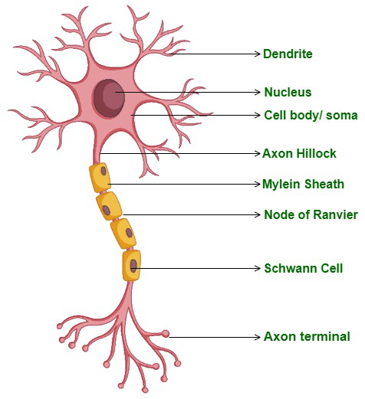
Structure and function of the Neuron
Neuron (nerve cell)
Information-processing and information transmitting element of the nervous system
Types: Sensory, Motor, Interneuron
Five structures
Cell body (Soma): contains Nucleus which provides life to the cell
Dendrites: Treelike structure attached to soma, receives information from the terminal buttons of other neurons

Slide 4
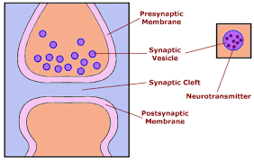
Structure and function of the Neuron
3. Axon: Long, thin, cylindrical structure, conveys information from the soma of a neuron to its terminal buttons
The axon ends in a cluster of Terminal buttons, which are small knobs secrete chemicals called Neurotransmitters.
4. Myelin Sheath:
An insulating (protecting) material that encases some axons
5. Synapse: A junction between the terminal button of an axon and the membrane of another neuron.
For transmission of information
Synapse (structure)

Slide 5
Neurotransmitters
Definition:
A neurotransmitter is defined as a chemical that is released by a terminal button; has an excitatory or inhibitory effect on another neuron
Important Neurotransmitters:
Dopamine
Serotonin
Endorphins
Acetylcholine

Slide 6
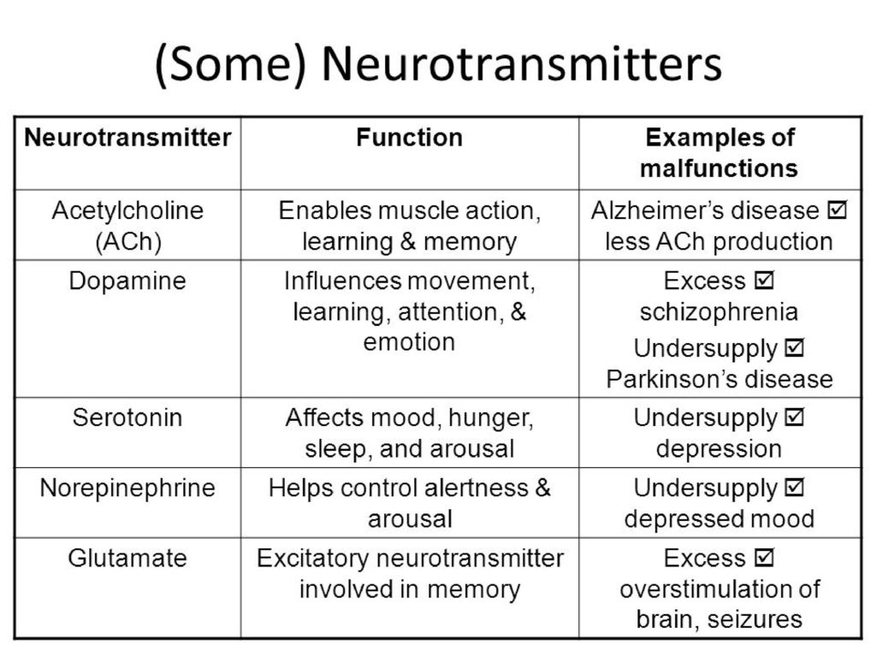
Functions & malfunctions of Neurotransmitters

Slide 7
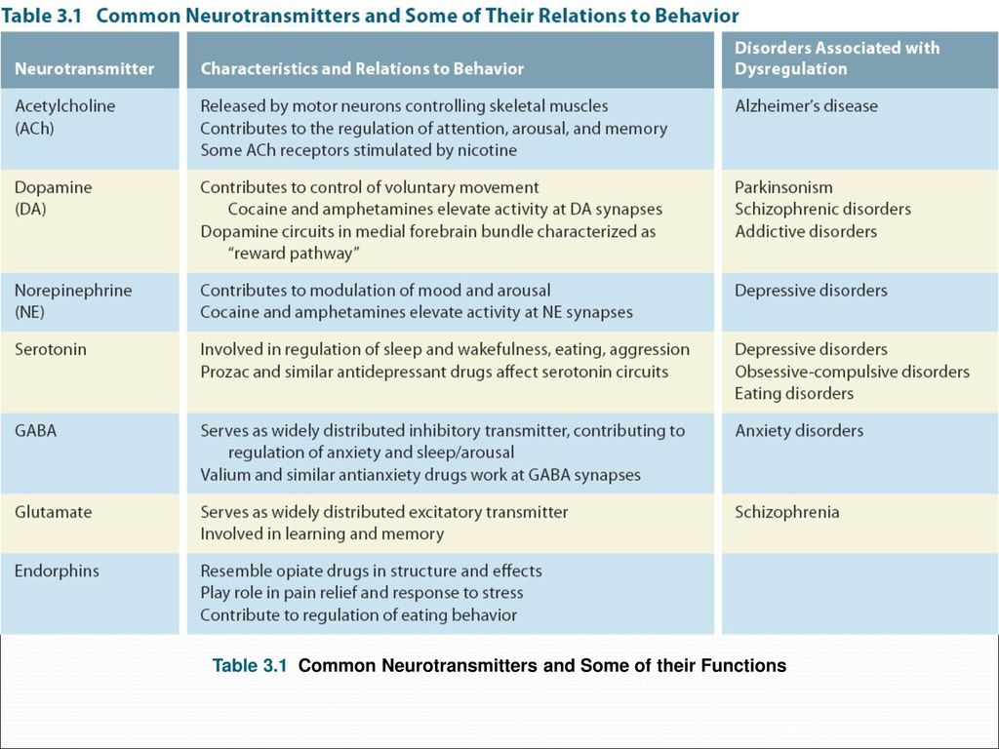

Slide 8
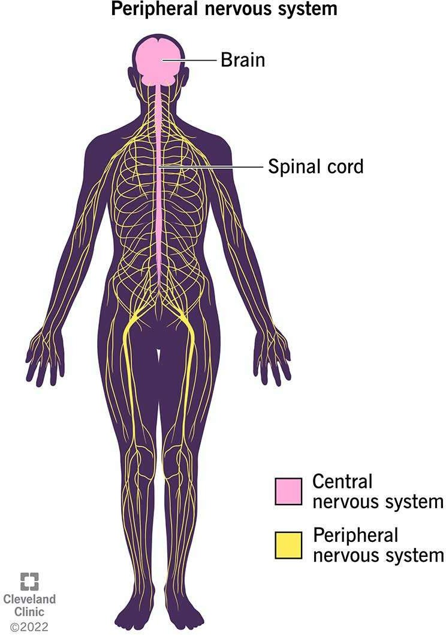
Nervous System

Slide 9
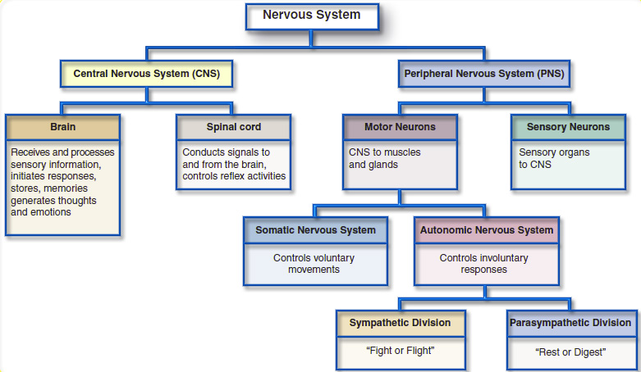
Division of Nervous System

Slide 10
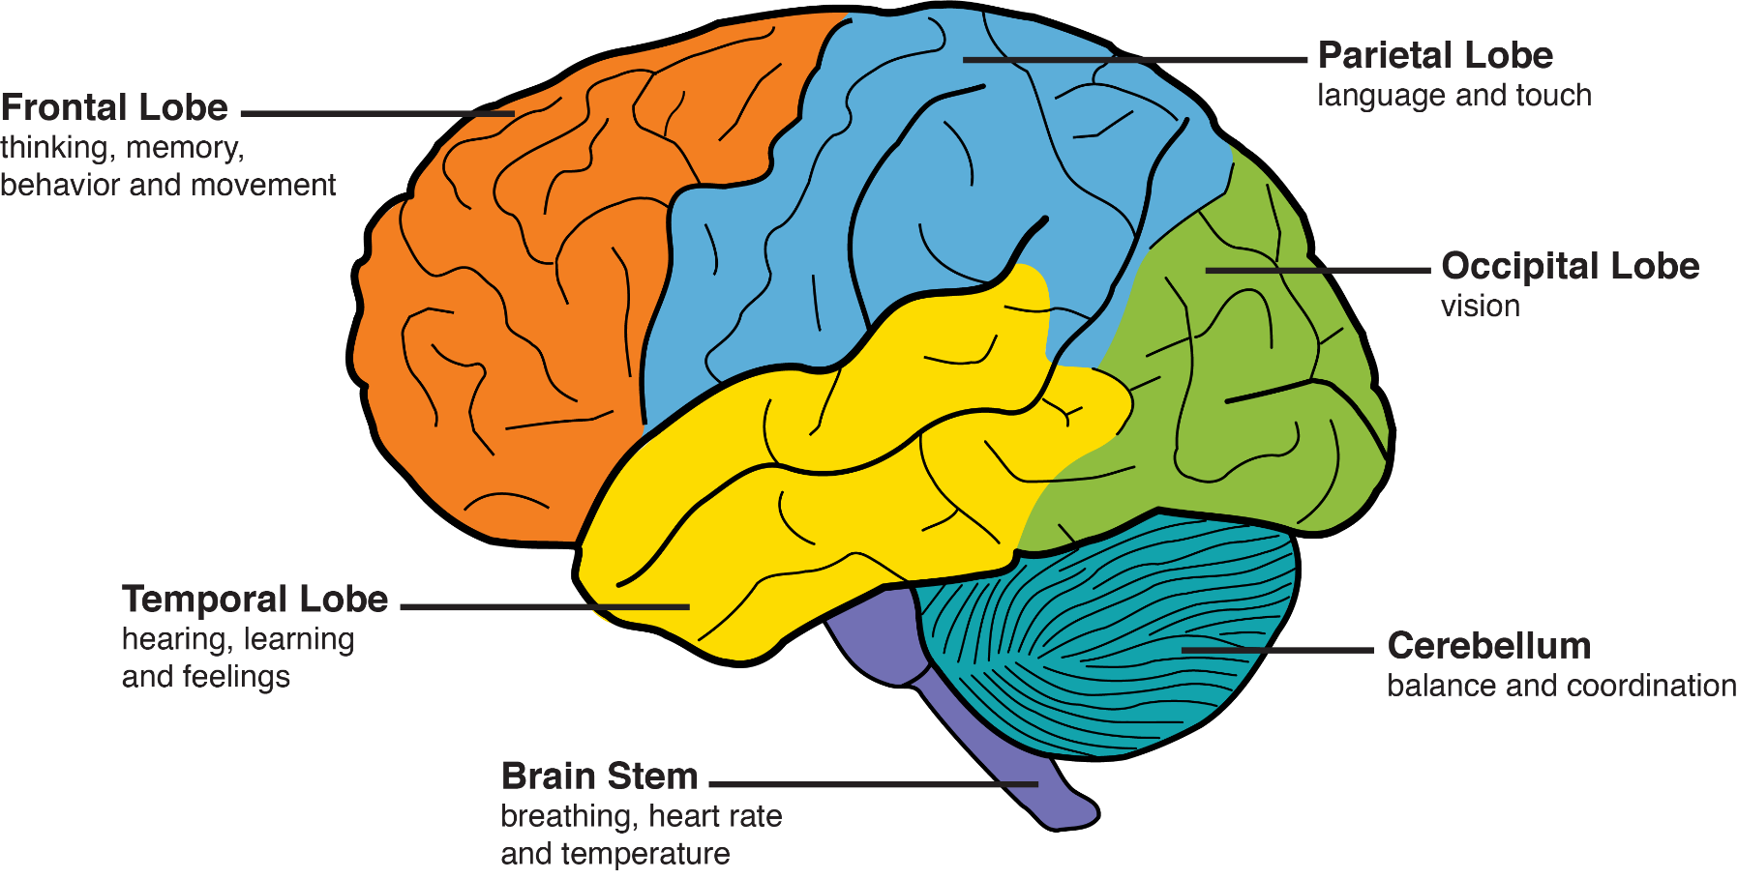
Cerebrum (slide not included in Mid-1

Slide 11
Peripheral Nervous system
connect to voluntary
skeletal muscles and to Take msgs to and forth
The Somatic Nervous System
sensory receptors.
to the CNS & body
PNS
made up of nerves that
sympathetic division
The Autonomic Nervous System (ANS)
connect to the heart,
blood vessels, smooth muscles, and glands.
parasympathetic division

Slide 12
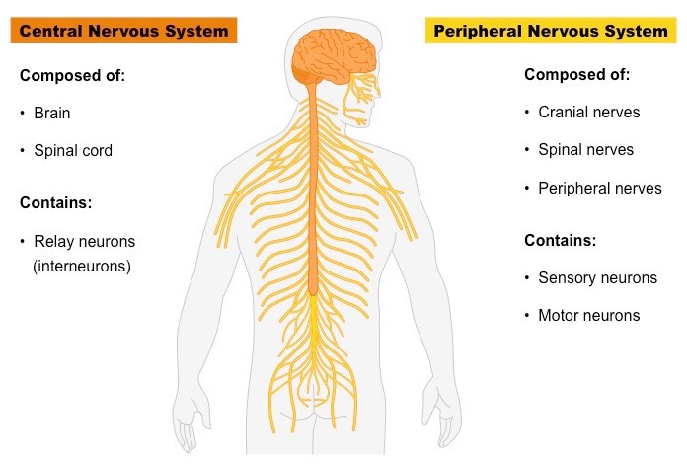
Peripheral Nervous System
Periphery means (the outside)
The Peripheral Nervous System is made up of all those nerves that lie outside the brain and spinal cord.
PNS has 2 subdivisions:
1. Somatic Nervous System
2. Autonomic Nervous System

Slide 13
Peripheral Nervous System
1. Somatic Nervous System
2. Autonomic Nervous System
The Somatic Nervous System is made up of nerves that connect to voluntary skeletal muscles and to sensory receptors.
Carries information from skin, muscles and joints to CNS and carry commands from CNS to muscles.
The Autonomic Nervous System (ANS) is made up of nerves that connect to the heart, blood vessels, smooth muscles, and glands.
performs involuntary functions such as heart rate, digestion, and perspiration.
Divisions of ANS :
1. Sympathetic: Mobilizes body’s resources in emergencies
2. Parasympathetic: conserves bodily resources

Slide 14
Divisions of Autonomic Nervous System
i. The sympathetic division
ii. The parasympathetic division
The sympathetic division is the branch of ANS that mobilizes the body’s resources for emergencies.
It creates the Fight-or-Flight Response
Slows digestive processes
Drains blood
The parasympathetic division is the branch of ANS that conserves bodily resources
It activates processes that allow the body to save and store energy
E.g. promotes digestion
slows heart rate
Reduces blood pressure

Slide 15
The Central Nervous System
Hindbrain
Brain
Midbrain
CNS
Spinal Cord
Forebrain

Slide 16
Spinal cord | Brain
The spinal cord connects the brain to the rest of the body through the peripheral nervous system | The crowning glory of the CNS is the Brain, weighs about 3 pounds. Contains billions of interacting cells that integrate information from inside and outside the body
Bundles of axons carry the brain’s commands to peripheral nerves and that relay sensations from the periphery of the body to the brain | Coordinates the body’s actions. Enables human beings to talk, think, remember, plan, create, and dream

Slide 17
Division of Brain
1. The Hindbrain | 2. The Midbrain
Controls largely unconscious Controls breathing, maintaining muscle tone Involved in sleep and arousal Coordination of movement, sense of equilibrium/ physical balance | Integration of sensory processes such as vision and hearing System of dopamine-releasing neurons Voluntary movements Modulation of muscle reflexes Breathing & pain perception
Damage to this brain part disrupts fine motor skills involved in writing, typing, or playing a musical instruments | Decline in dopamine synthesis causes Parkinson’s Disease

Slide 18
3. The Forebrain
The forebrain is the largest and most complex region of the brain
All sensory information must pass sensing touch, hearing
A Regulator of Biological Needs, hunger, thirst, sexual motivation, and temperature regulation
One such function is to control the autonomic nervous system
A vital link between the brain and the endocrine system
Basic biological drives related to survival, including the so- called “four F’s”: fighting, fleeing, feeding, and mating.
Emotion, memory, and motivation
Pleasure centers
Central role in the learning of fear responses
Learning, remembering, thinking,
Control over, such as fingers, lips, and the tongue
Acquisition of new motor skills
Imitation of others
The understanding of others’ intentions and the ability to feel empathy
Reasoning about relations between objects and events
Decision making
executive control system,” which is thought to monitor, organize, integrate, and direct thought

